Slide 1
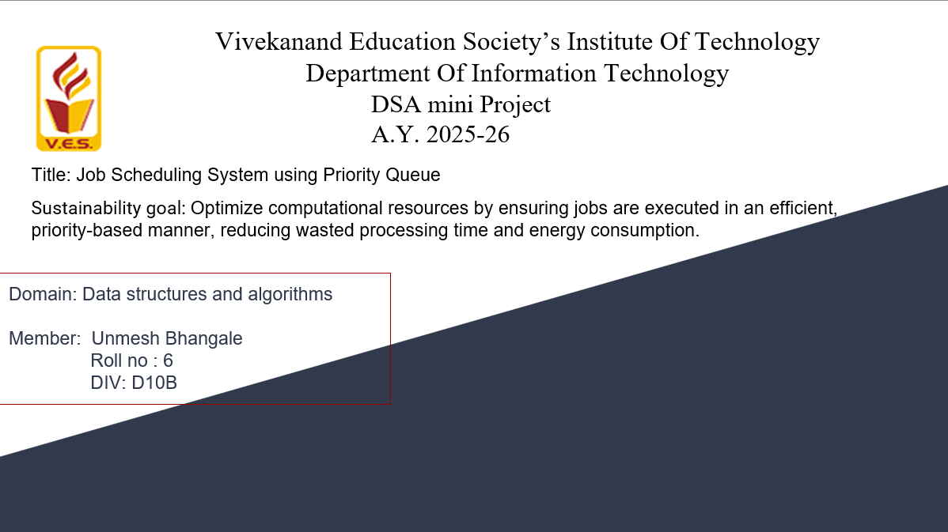

Slide 2


Slide 3

Content
Introduction to the Project
Problem Statement
Objectives of the Project
Scope of the Project
Requirements of the System (Hardware, Software)
ER Diagram of the Proposed System
Data Structure & Concepts Used
Algorithm Explanation
Time and Space Complexity
Front End
Implementation
Gantt Chart
13. Test Cases
14.Challenges and Solutions
15. Future Scope
16. Code
17. Output Screenshots
18. Conclusion
19. References (in IEEE Format)

Slide 4
Introduction to Project
r Rates
Job Scheduling is a fundamental concept in computer science and operating systems. It deals with deciding the order in which jobs/processes should be executed by the system. A job can be a program, a task, or a request waiting for execution.
In a priority scheduling system, every job is assigned a priority value, and jobs with higher priority are executed before jobs with lower priority. This ensures that urgent or critical tasks get processed first.
My project simulates a Job Scheduling System using the Priority Queue data structure, where we can add jobs, display them, and execute them in priority order.

Slide 5
Problem Statement
r Rates
JOB SHEDULING SYSTEM USING PRIORITY QUEUE
n traditional scheduling methods like First Come First Serve (FCFS), jobs are executed in the order they arrive. However, this does not consider the importance or urgency of jobs. For example, a critical job may be delayed if it arrives after several lower-priority jobs.
This leads to inefficiency and delays in execution. Therefore, a system is needed that can handle jobs based on priority values rather than just arrival time.

Slide 6
Objectives of the project
r Rates
To design and develop a menu-driven scheduling system.
To allow insertion of jobs with different names and priorities.
To maintain a priority queue for execution.
To provide functions to add jobs, display the queue, and execute jobs.
To demonstrate the application of data structures in system scheduling.

Slide 7
Requirements of the system (Hardware, software)
lem Statement
Problem Statement
Hardware Requirements:
Processor: Intel i3 or above
RAM: Minimum 4GB
Storage: 200MB free space
Software Requirements:
Operating System: Windows / Linux
Compiler: GCC / Turbo C
Language: C
Editor: VS Code / Code::Blocks

Slide 8
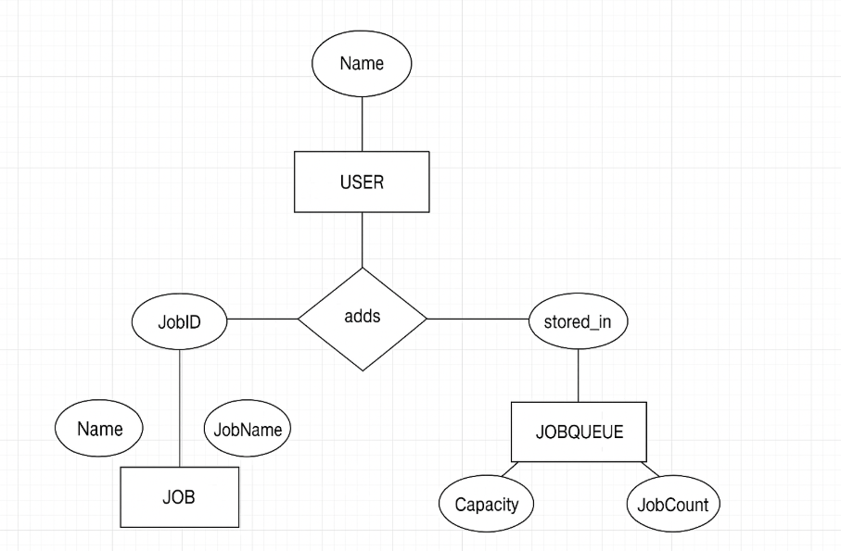
ER diagram of the proposed system

Slide 9
Front End
Console-based interface using menu-driven program.
Input: Job details (Name + Priority).
Output: Job Queue status and execution messages.

Slide 10
Implementation
Functions: addJob(), displayJobs(), executeJob().
Control: switch-case driven main menu.
Data Structure: Array-based priority queue.

Slide 11
Gantt Chart
Higher priority = earlier execution
If two jobs have the same priority, they are executed in the order they were inserted.
Let’s assume the user entered the following jobs:
Execution Order (based on priority):
Job B (Priority 5)
Job D (Priority 4)
Job A (Priority 3)
Job C (Priority 2)
JobID | JobName | Priority
1 | A | 3
2 | B | 5
3 | C | 2
4 | D | 4
Time → 0 1 2 3
|----|----|----|----|
Job → B D A C
Notes:
The max flow algorithm in the visualization is :-

Slide 12
Test cases
Test Case | Input | Expected Output
1 | Add 3 jobs: J1(priority=5, burst=4, arrival=0), J2(priority=8, burst=3, arrival=1), J3(priority=3, burst=2, arrival=2) | Queue order → J2 → J1 → J3; Execution order same; Waiting times and turnaround times calculated correctly
2 | Add jobs with same priority (J1, J2 both priority=7) | Tie resolved by arrival order (the one added first runs first)
3 | Execute when queue is empty | System should print ⚠ "No jobs to execute"
4 | Add more than MAX (100) jobs | System should print ⚠ "Queue full! Cannot add more jobs."
5 | Search for job ID that does not exist | Should print ❌ "Job not found"
6 | Job arrives later than current time (arrival=5 but CPU idle at 0) | CPU waits until arrival=5 before executing job

Slide 13
Challenges and solutions
Challenge | Explanation | Solution
Maintaining priority order efficiently | Insertion in array requires shifting elements (O(n)) | Use a Heap-based Priority Queue for O(log n) insertion
Handling jobs with same priority | Ambiguity which job to run first | Use FCFS (First Come First Serve) rule to break ties
CPU idle time | When no jobs are available before current time | Add check for arrival time and keep CPU idle until a job arrives
Scalability | Array-based queue limited to MAX=100 | Use dynamic memory allocation (linked list / heap) for larger queues
Preemption | Current system is non-preemptive (once job starts, it finishes) | Extend to Preemptive Priority Scheduling for real OS-like behavior

Slide 14
Future Scope
Preemptive Scheduling Implement real-time interruption when a higher-priority job arrives mid-execution.
Multi-Processor Scheduling Extend to handle multiple CPUs (parallel job execution).
Different Scheduling Algorithms Add support for Round Robin, SJF (Shortest Job First), Multilevel Queue Scheduling.
Graphical User Interface (GUI) Create a visualization of the Gantt chart (timeline) for better understanding.
Persistent Storage
Store jobs in a database so system state is not lost when the program ends.
Integration with Cloud / Distributed Systems Extend scheduler to allocate jobs across distributed servers (like Kubernetes job scheduling).

Slide 15
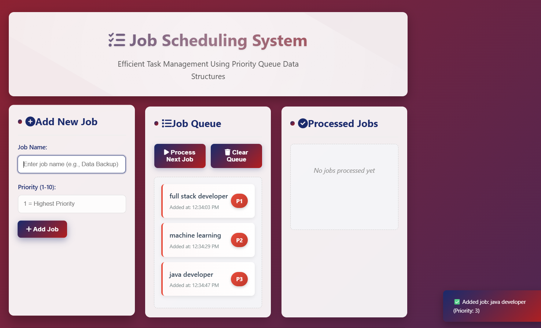
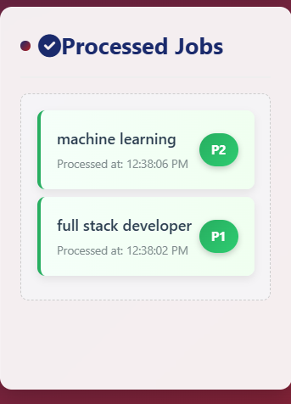
OUTPUT SCREENSHOT

Slide 16
Conclusion
The project demonstrates how priority scheduling can be effectively implemented using the priority queue data structure.
It shows the importance of job prioritization in real-world systems and provides a base that can be extended into more complex scheduling algorithms used in operating systems.

Slide 17
References
E. Horowitz, S. Sahni, “Fundamentals of Data Structures in C,” Computer Science Press.
GeeksforGeeks, “Priority Queue in Data Structures,”. Available: https://www.geeksforgeeks.org
TutorialsPoint, “Job Scheduling Algorithms,” [Online].
A. Silberschatz, P.B. Galvin, G. Gagne, “Operating System Concepts,” Wiley, 9th Edition.

